Slide 1


Breast Cancer Data Visualisation and Exploration
Berlin 42, Bayer Challenges
Project D: TEAM LIFE
28th August 2023

Slide 2

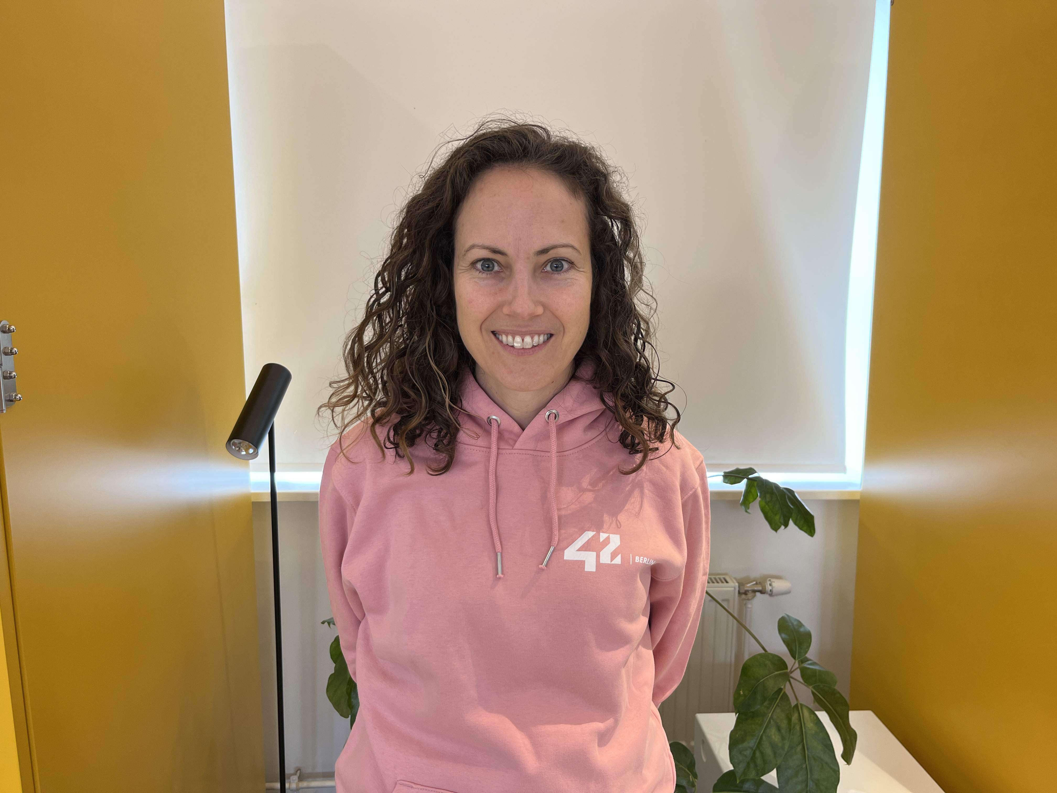
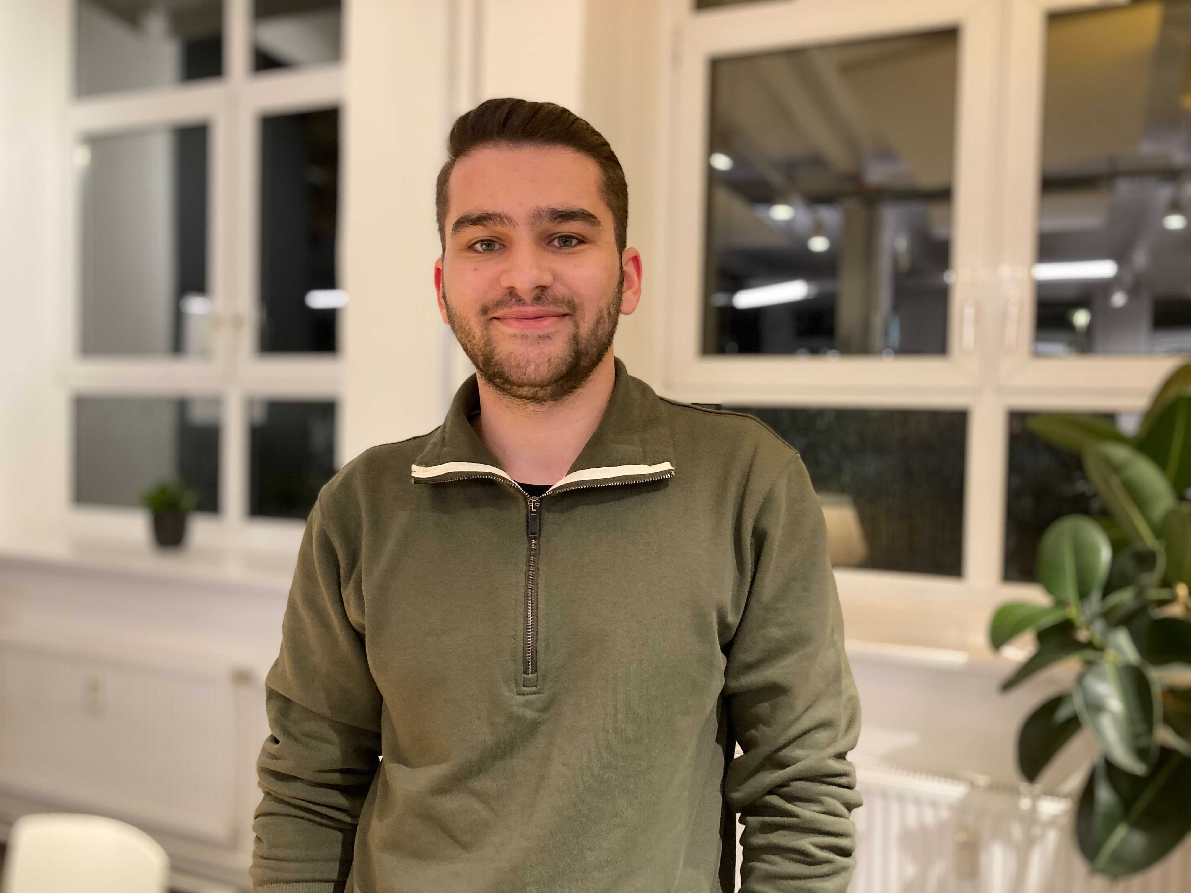
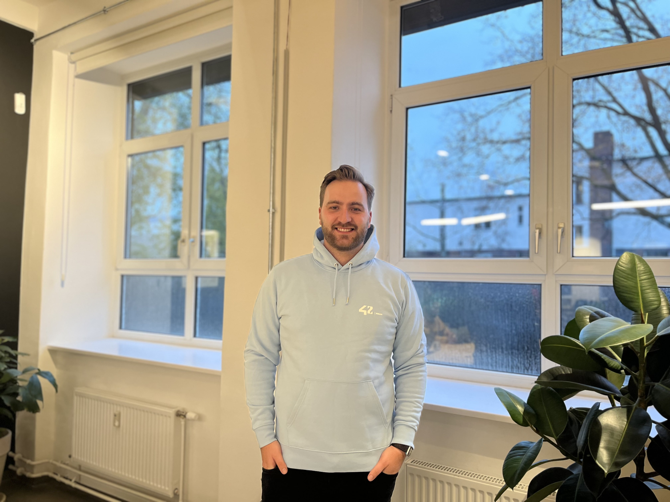
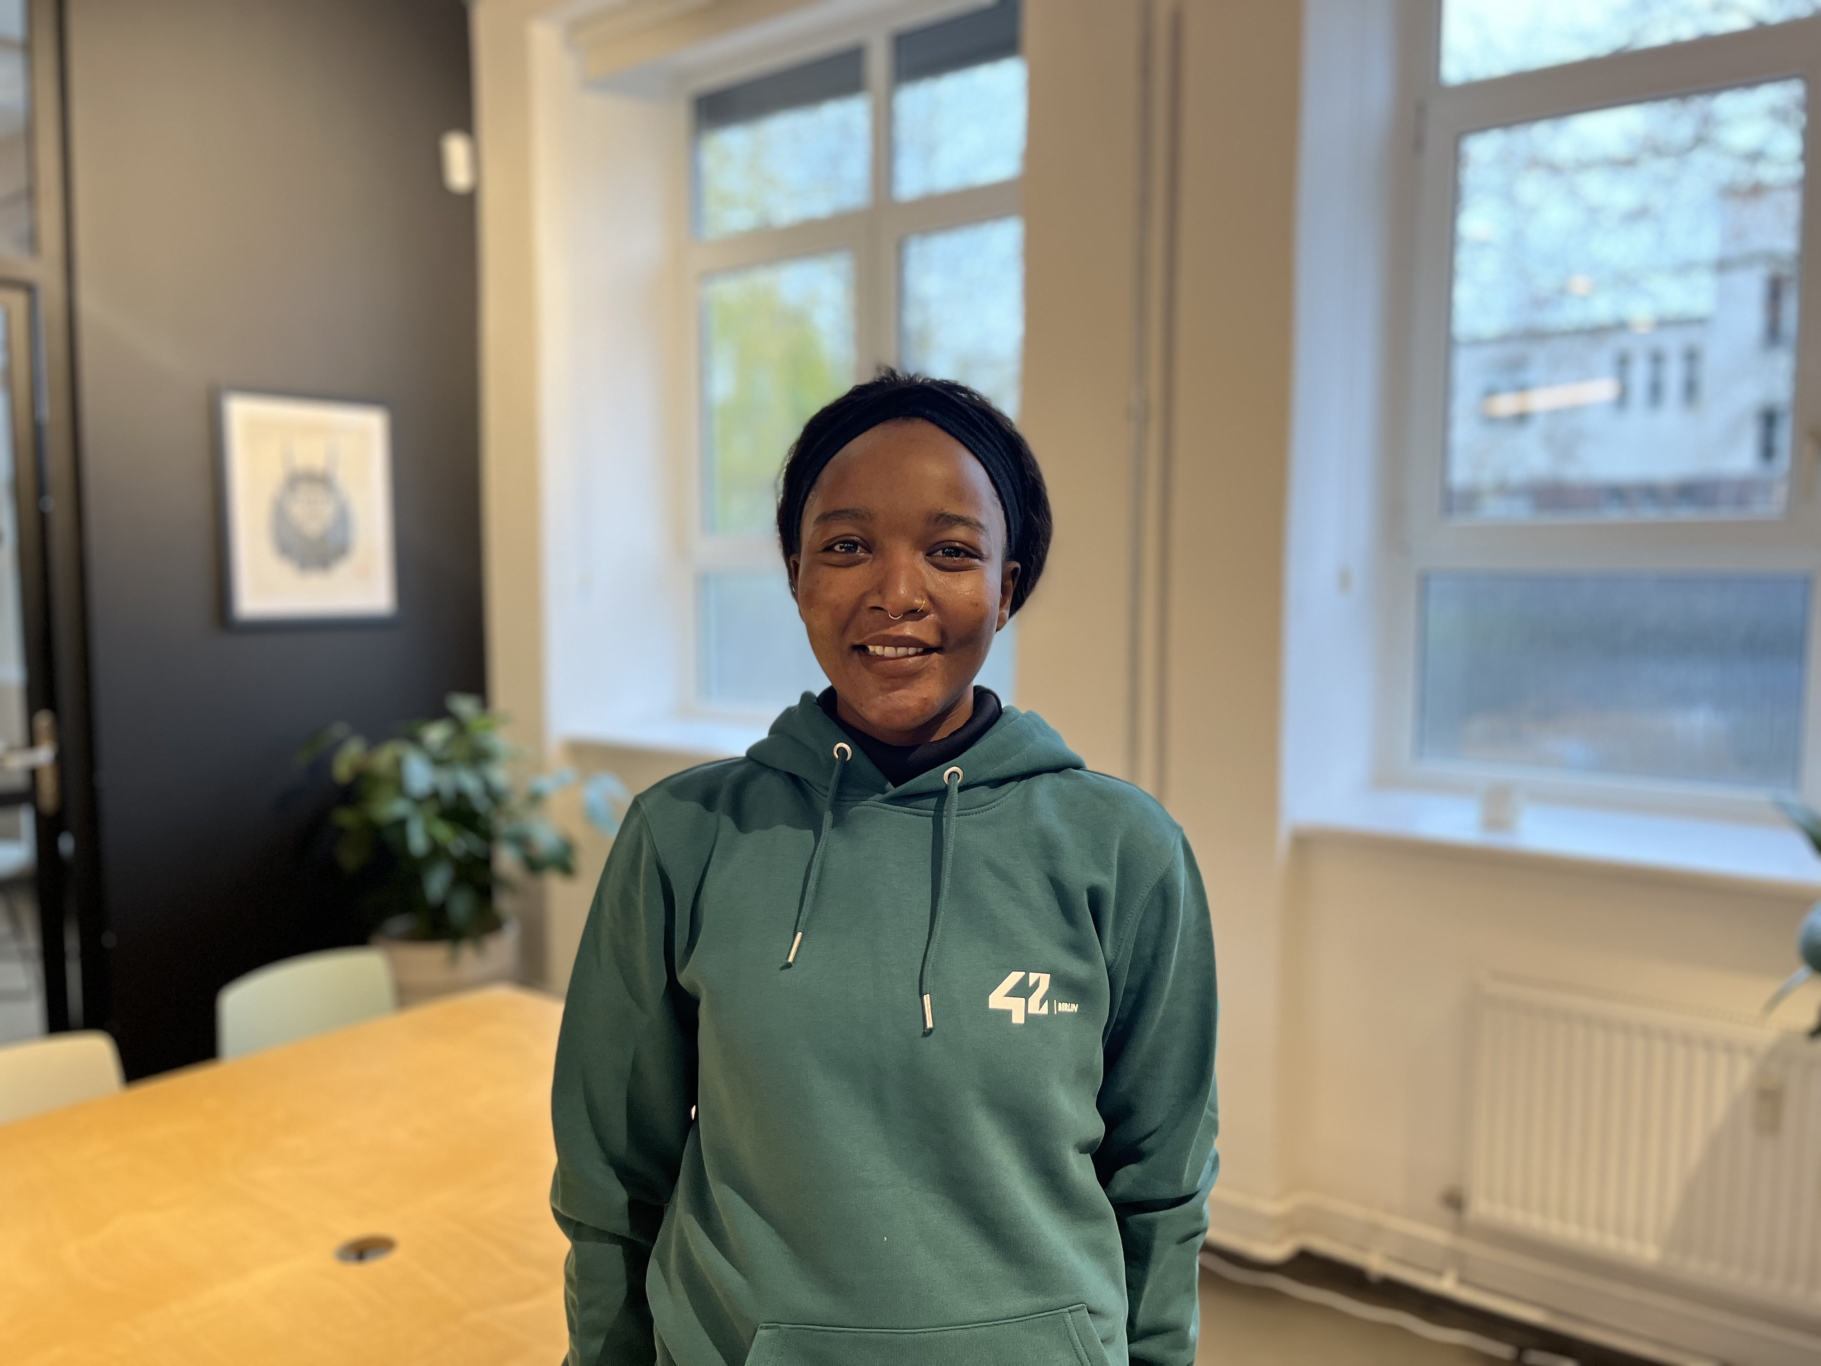
Project D: Team Life
Who we are
Karen
Mohammad
Max
Vanessa

Slide 3
Project D: Team Life
Machine Learning and Deploying Streamlit App
Dataset
Wisconsin Breast Cancer Dataset (also found on Kaggle)
consists of 30 features or categories (10 mean, 10 Standard Error, and 10 Worst) of measurements of tumor cells (includes both malignant and benign diagnosis):
Radius, texture, perimeter, area, smoothness, compactness, concavity, concave points, symmetry, and fractal dimension

Slide 4
Project D: Team Life
Machine Learning and Deploying Streamlit App
Situation
Breast cancer is 2nd leading cause of cancer related deaths in women
Delayed diagnosis has been shown to result in poor prognosis and higher treatment costs
Goal
Train a machine learning model to identify breast cancer.

Slide 5




Project D: Team Life
Machine Learning and Deploying Streamlit App
Explore the Dataset
Machine Learning
Learn python, pandas, and jupyter notebook
Explore different graphs
Perform Exploratory Data Analysis (EDA)
Review different machine learning models (ML) and learned about SHAP
Implement some models if possible.
Begin merging our dashboards
Week 1
Week 3
Week 5
Preperation
Create environment for python
and machine learning on our computers
Week 2
Create a Streamlit Dashboard
Week 4
Deploy Streamlit App
Learn how to use Streamlit
Explore and train pandasAI and OpenAI for our dashboard
Learned how to deploy a SHAP dashboard on our dashboard
Problem solve for the API key
Prepare for the presentation

Slide 6
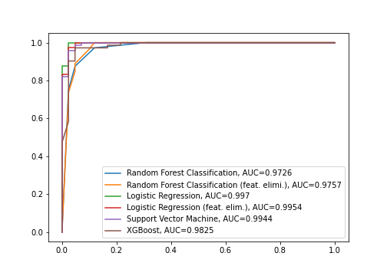
Project D: Team Life
Machine Learning Models
ROC of all Models Trained
Random Forest Classification:
grid search hyperperameter optimization
cross validation
feature importance analysis.
Logistic Regression:
feature importance using SHAP
used this model for our predictions
Interesting:
Both models had different approaches to training the models which was evident through the different feature importance used.

Slide 7
Project D: Team Life
Learning Curve
What was difficult?
Training the AI to properly respond
Congratulations! You have cancer!
AI responding they are not a doctor and therefore can‘t provide details.
Configuring the Streamlit app, there are always improvements to be made and we found it a bit too restrictive for fine tuning.
Including a SHAP dashboard on our Streamlit dashboard

Slide 8
Project D: Team Life
Closure
Conclusion
Machine Learning can:
improve diagnosis time.
decrase human error in analysis.
improve lives as early cancer detection means improved survival rates.
decrease medical costs (less time required to diagnose and less treatment costs).

Slide 9
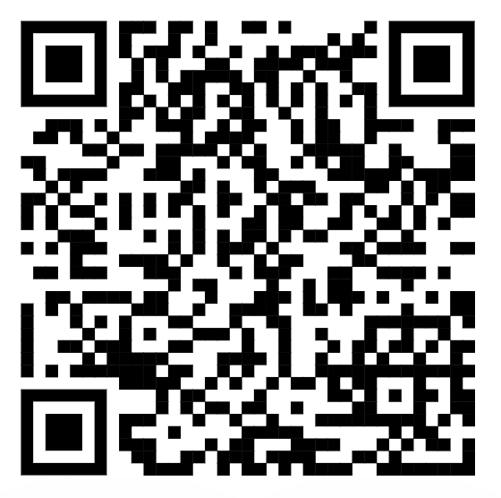
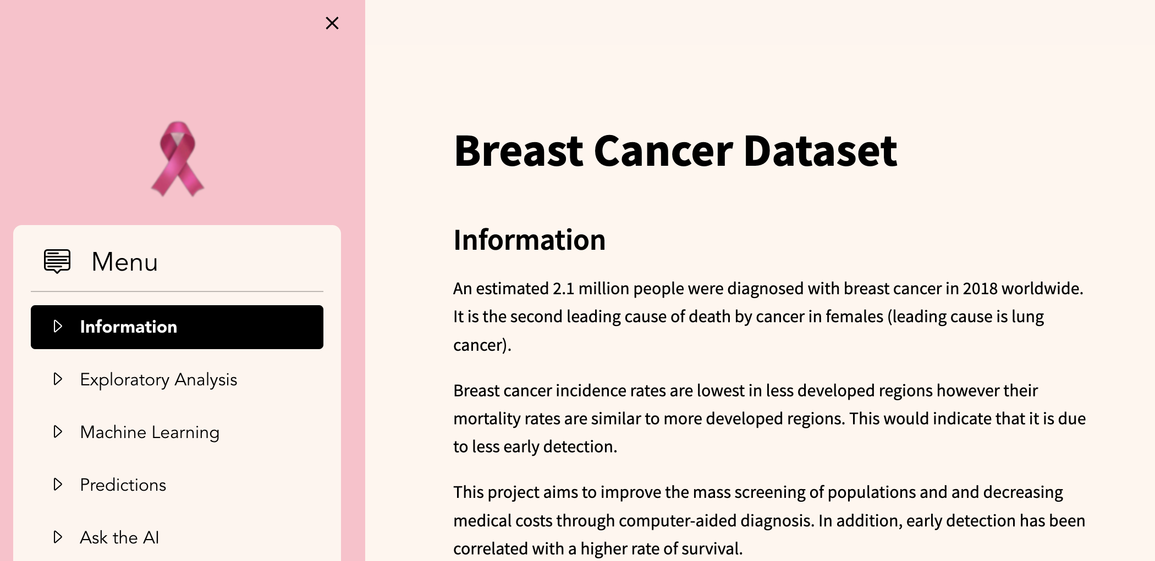
Project D: Team Life
Our app
https://bayerchallengedlife.streamlit.app/

Slide 10

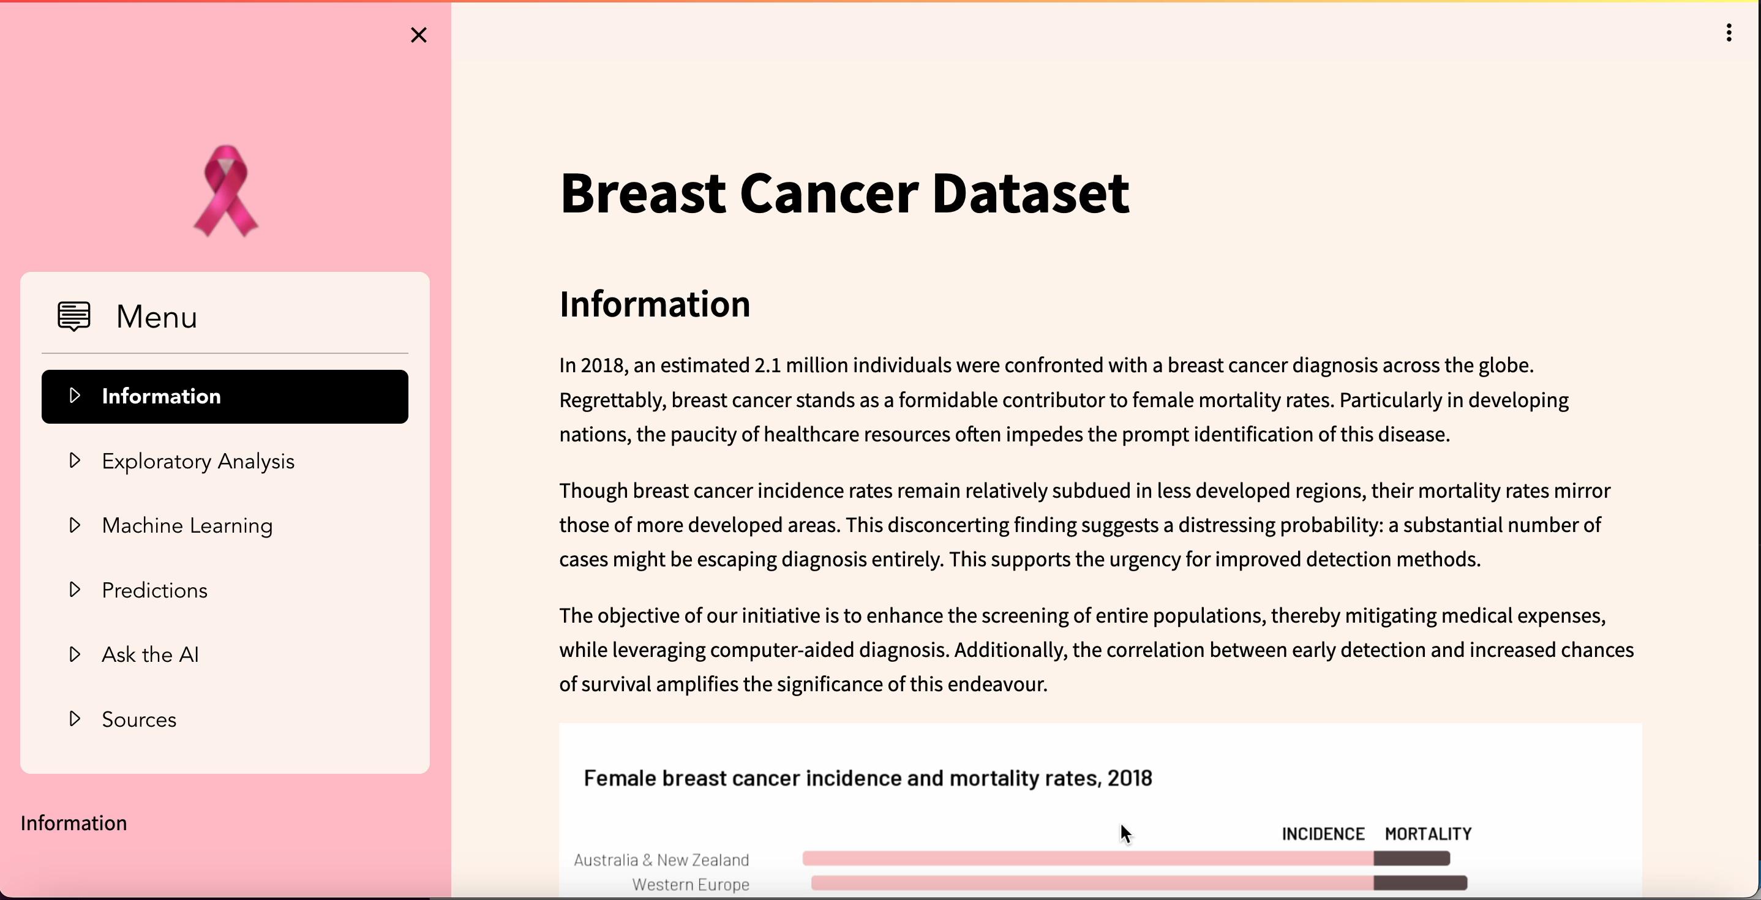

Slide 11
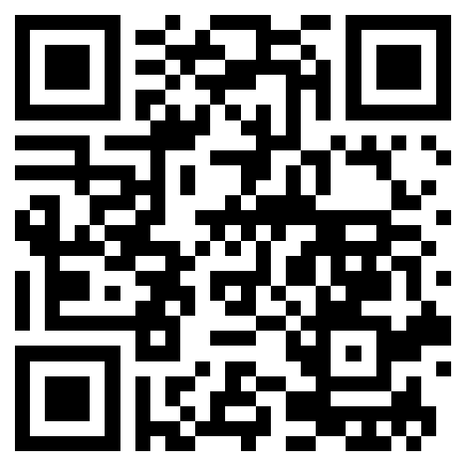
Project D: Team Life
Our details – keep in touch
Our Github Repository

